Slide 1

DIFFERENT SHAPES OF DATA
SEMINAR 3 – SQL part 3
Laszlo Sallo & SZILVESZTER MOLNAR

Slide 2
SEMINAR EXERCISES
SITE: https://b.socrative.com/login/student/
ROOM NAME:
CEUDSD

Slide 3
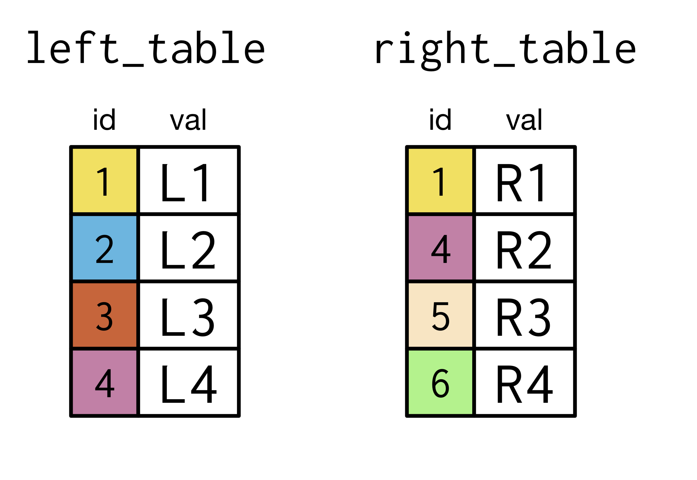
INNER JOIN

Slide 4
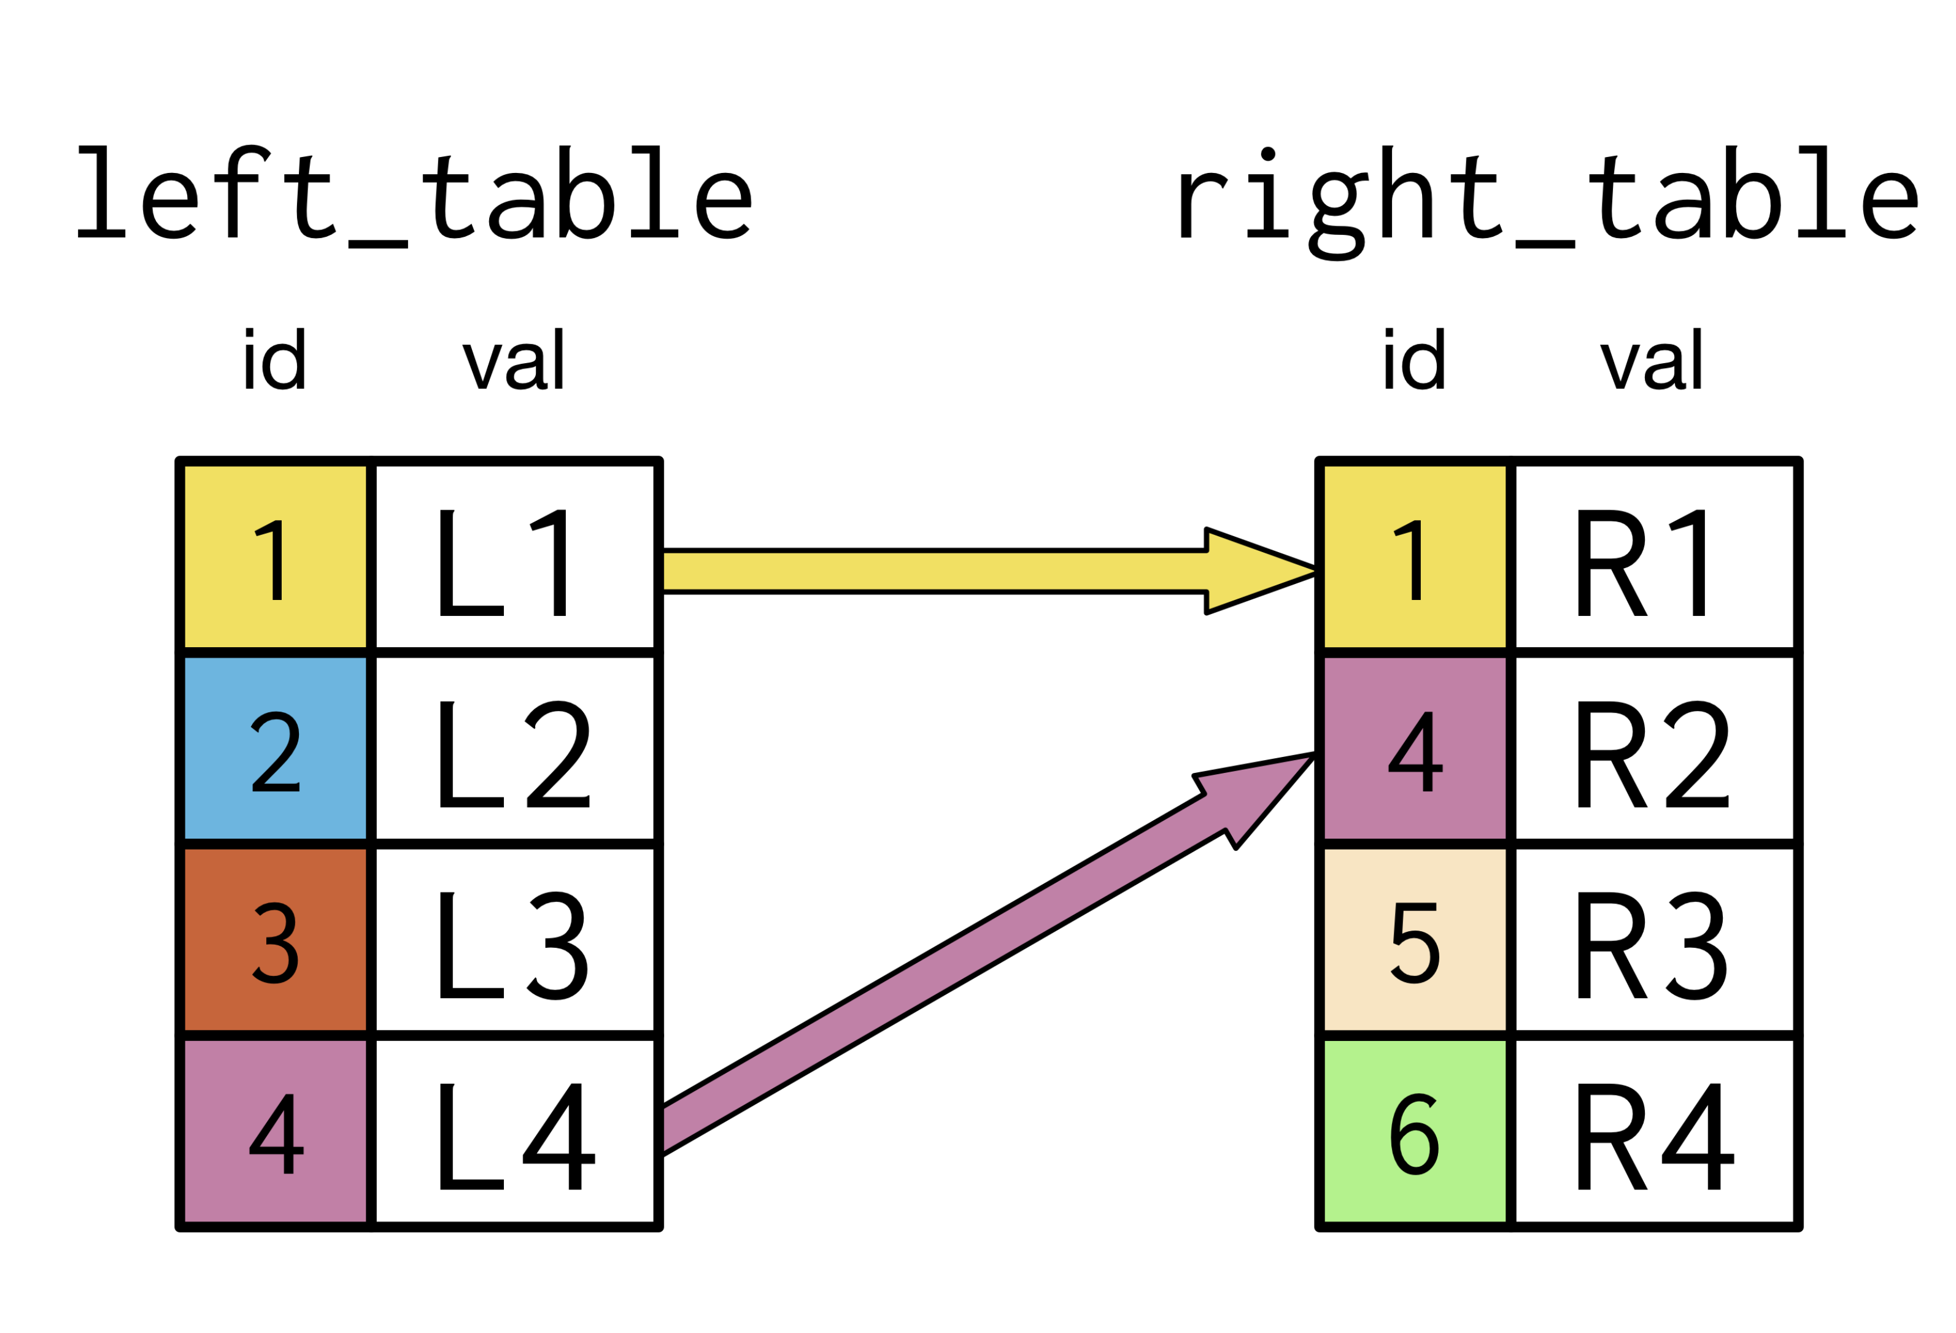
INNER JOIN

Slide 5
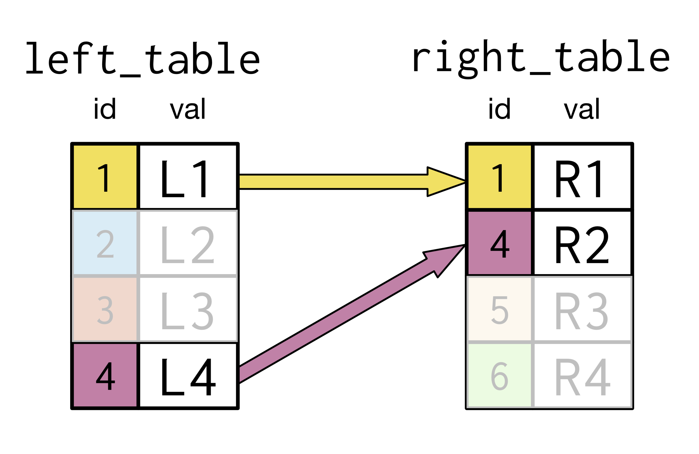
INNER JOIN

Slide 6
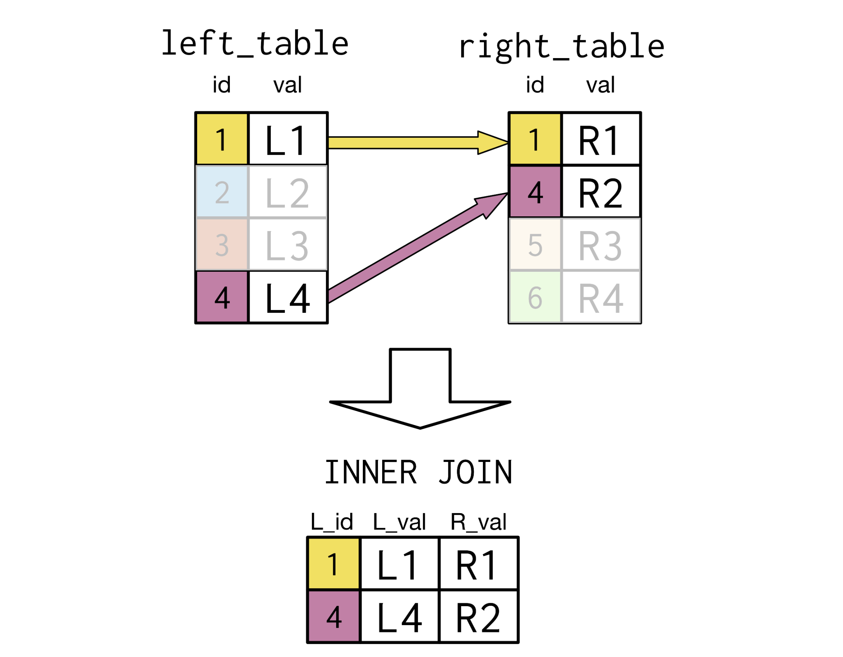
INNER JOIN 1:1

Slide 7
INNER JOIN 1:N

Slide 8
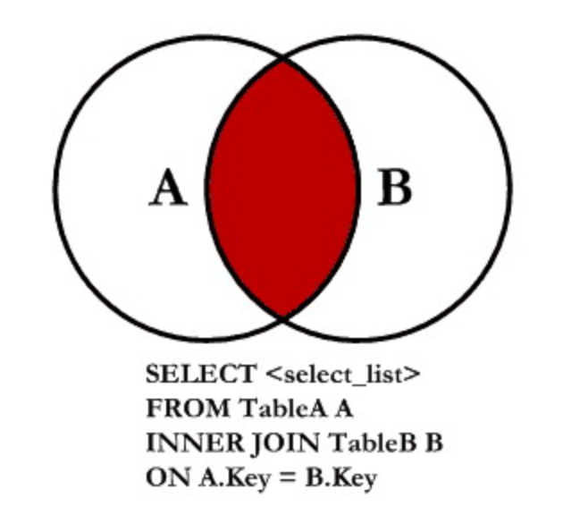
INNER JOIN FORM

Slide 9
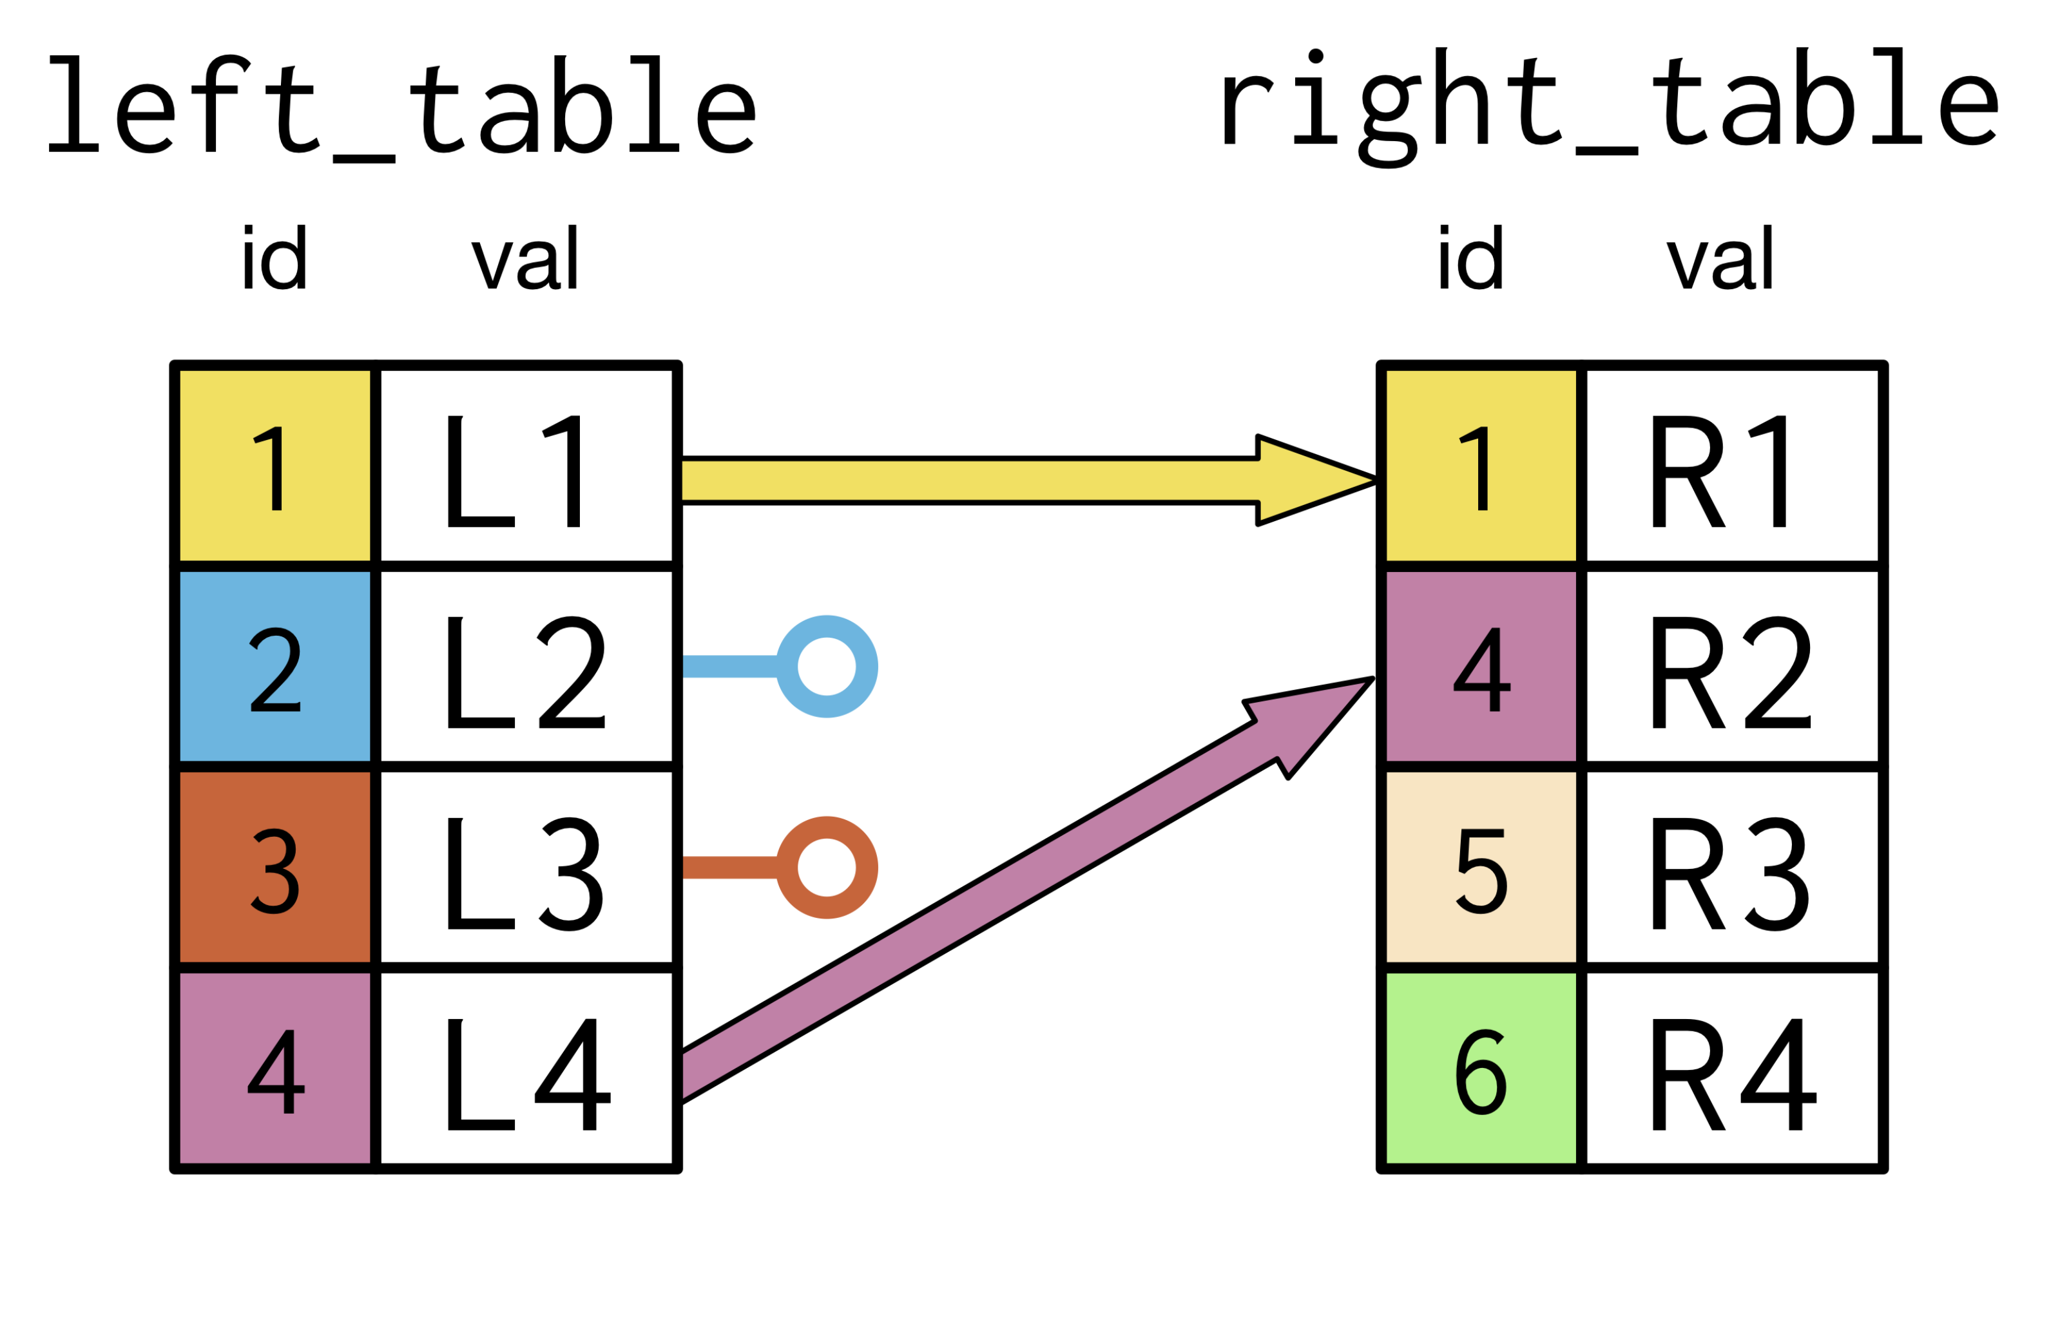
LEFT JOIN

Slide 10
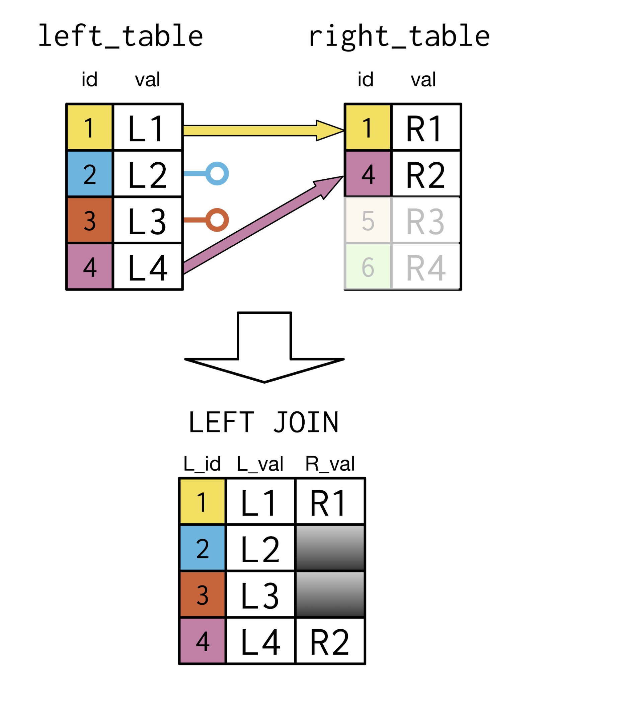
LEFT JOIN 1:1

Slide 11
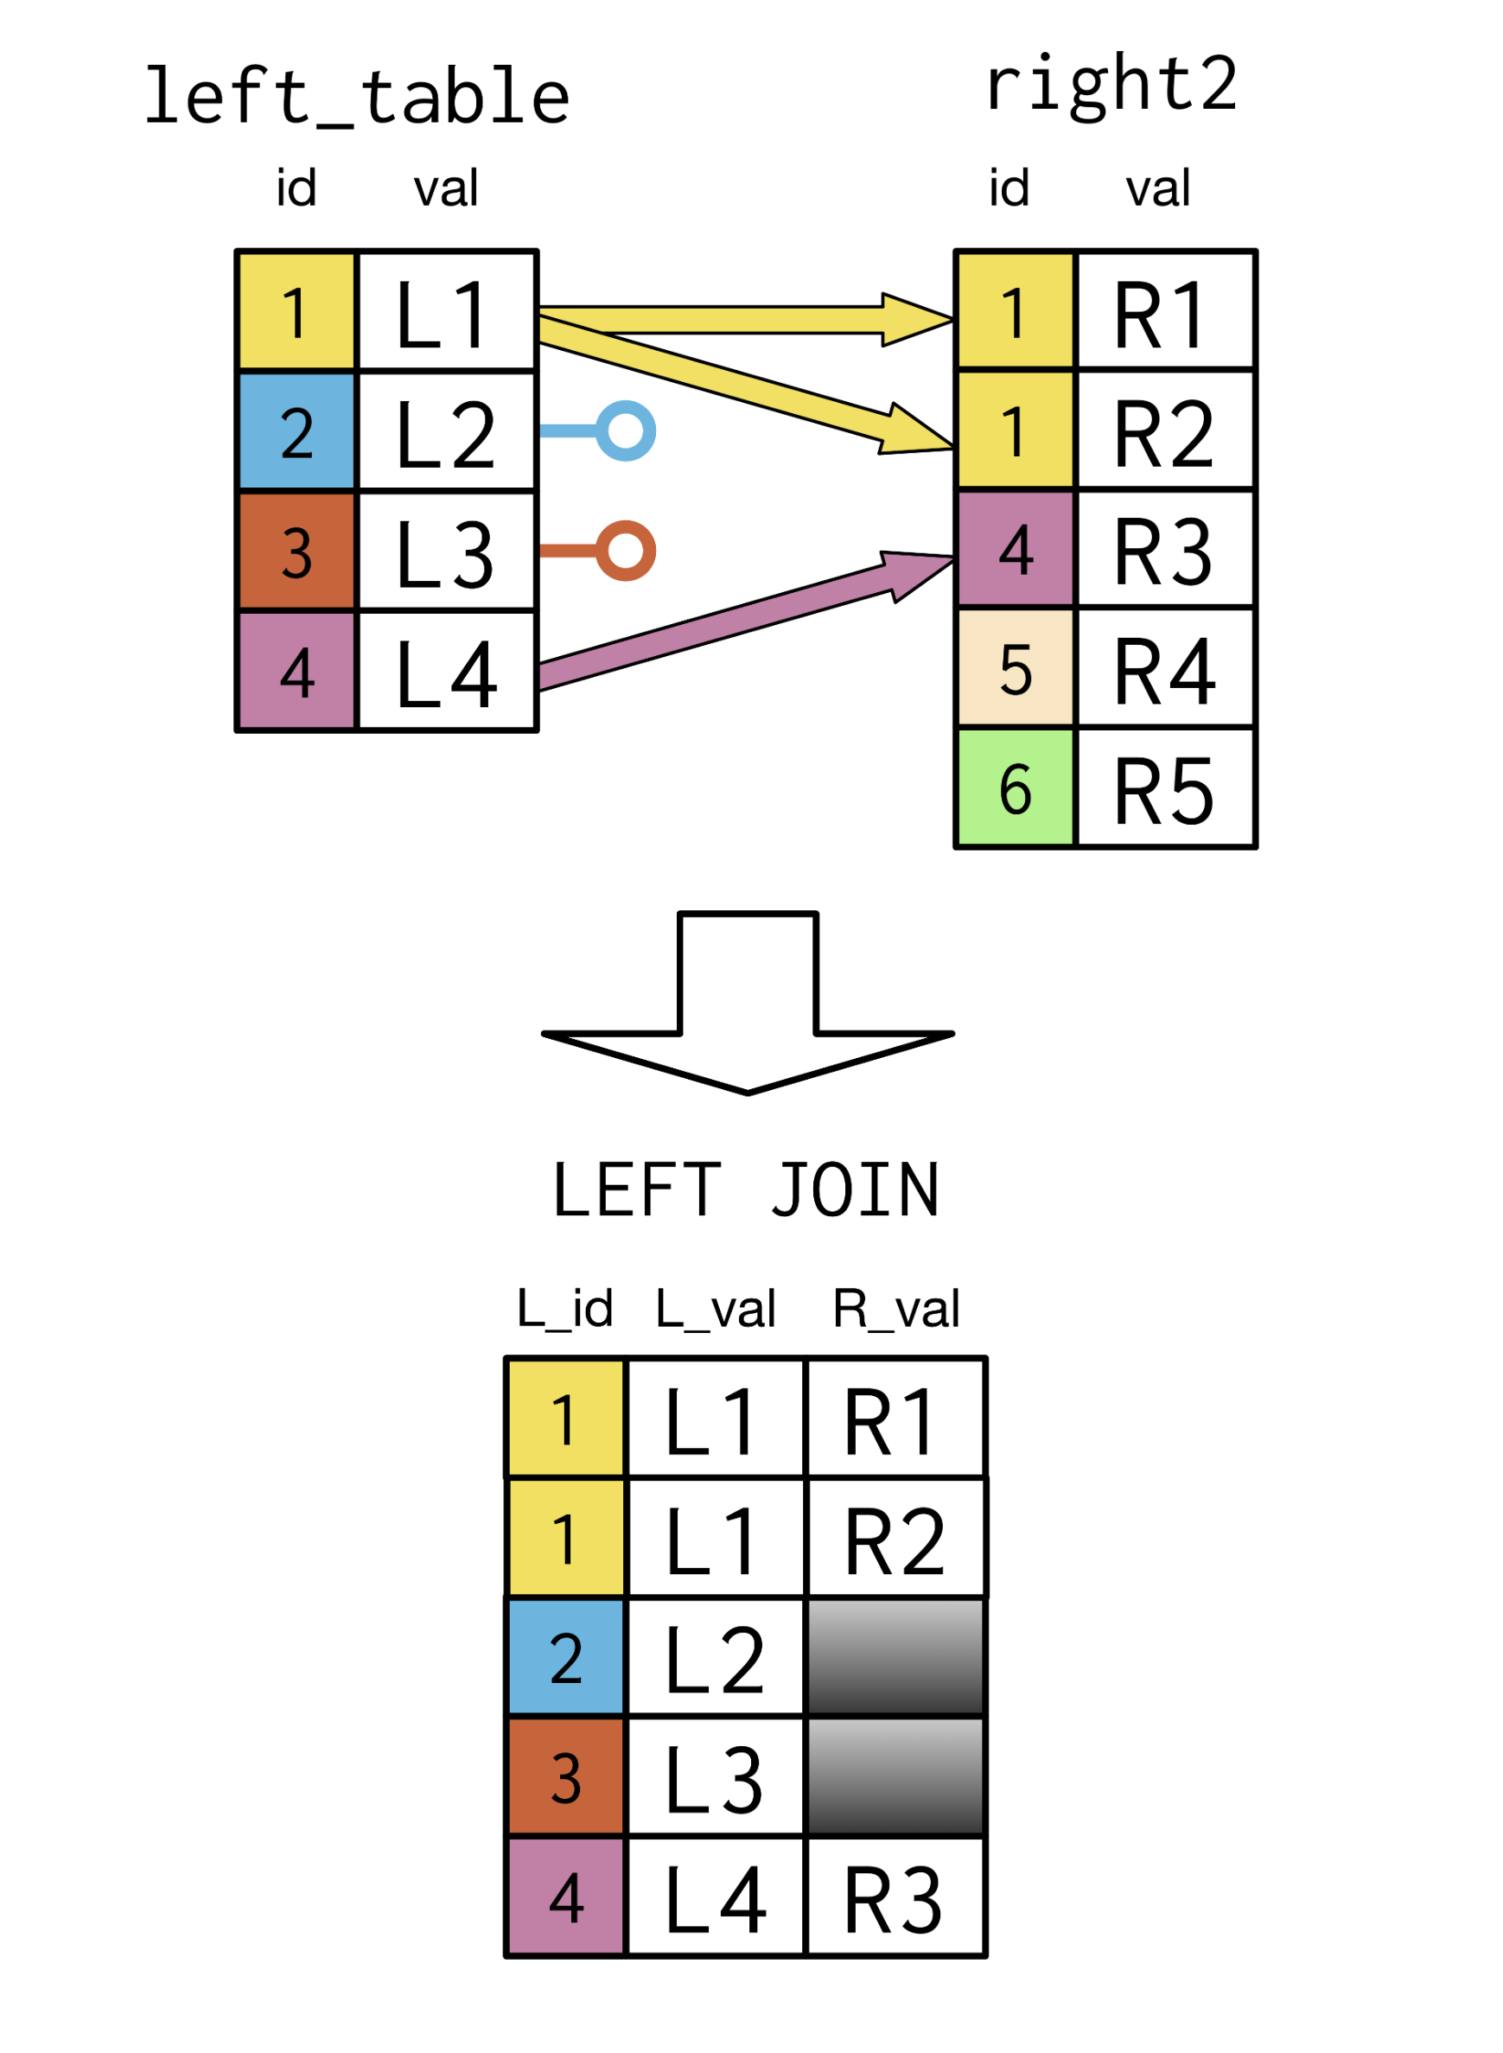
LEFT JOIN 1:N

Slide 12
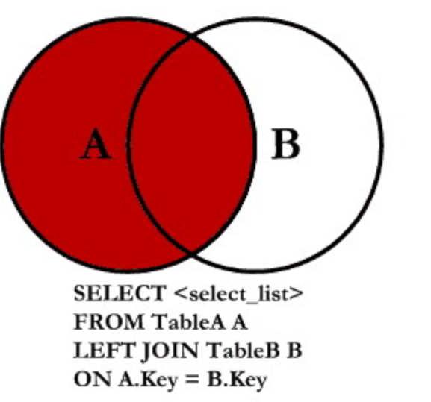
LEFT JOIN FORM

Slide 13
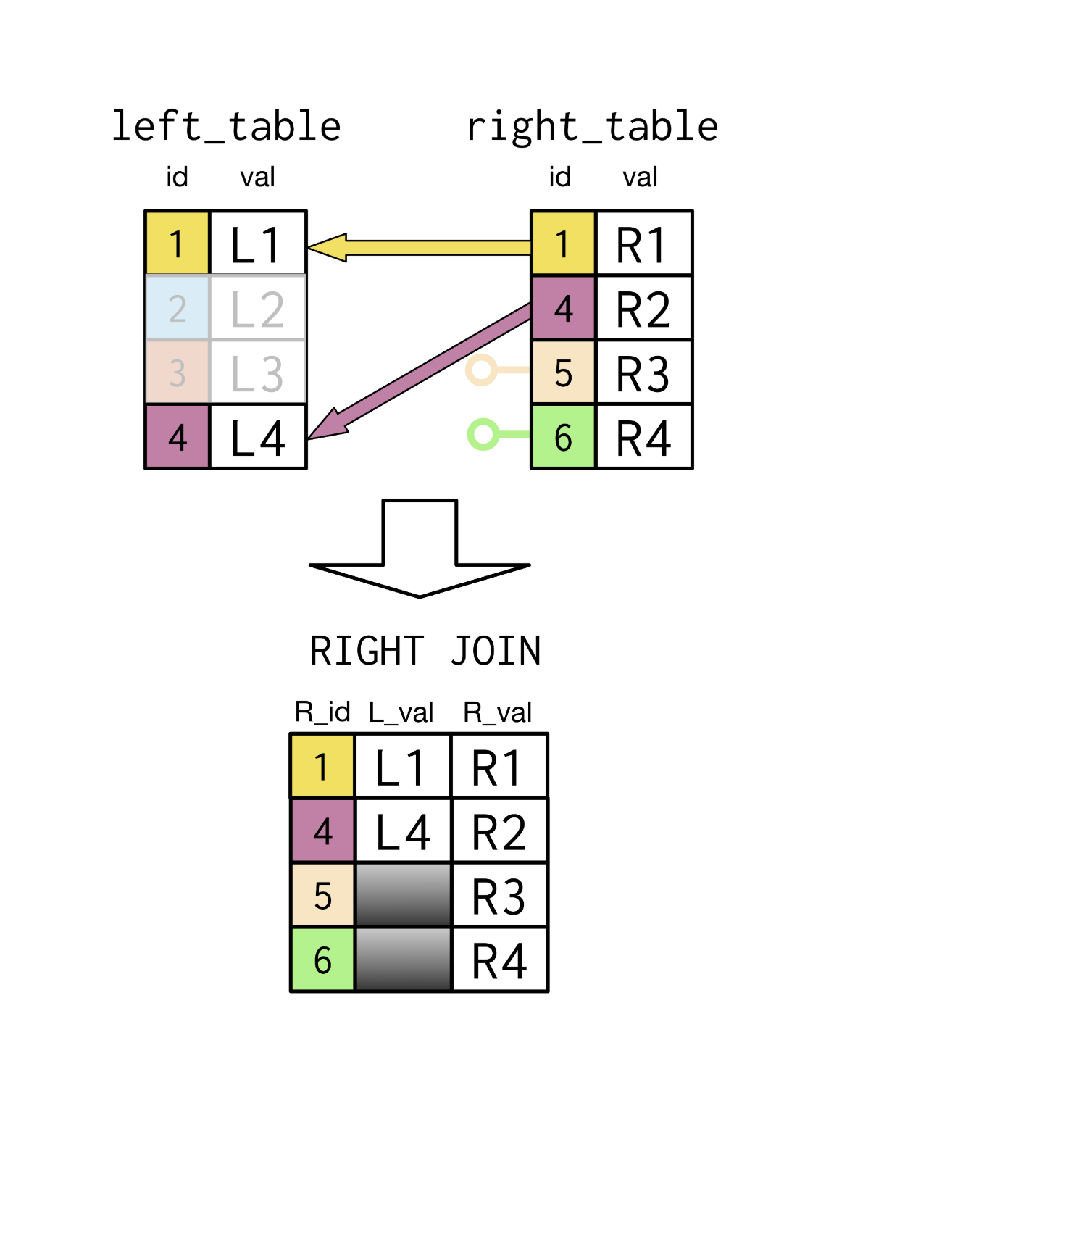
RIGHT JOIN

Slide 14
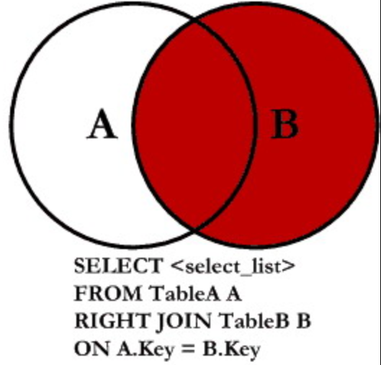
RIGHT JOIN FORM

Slide 15
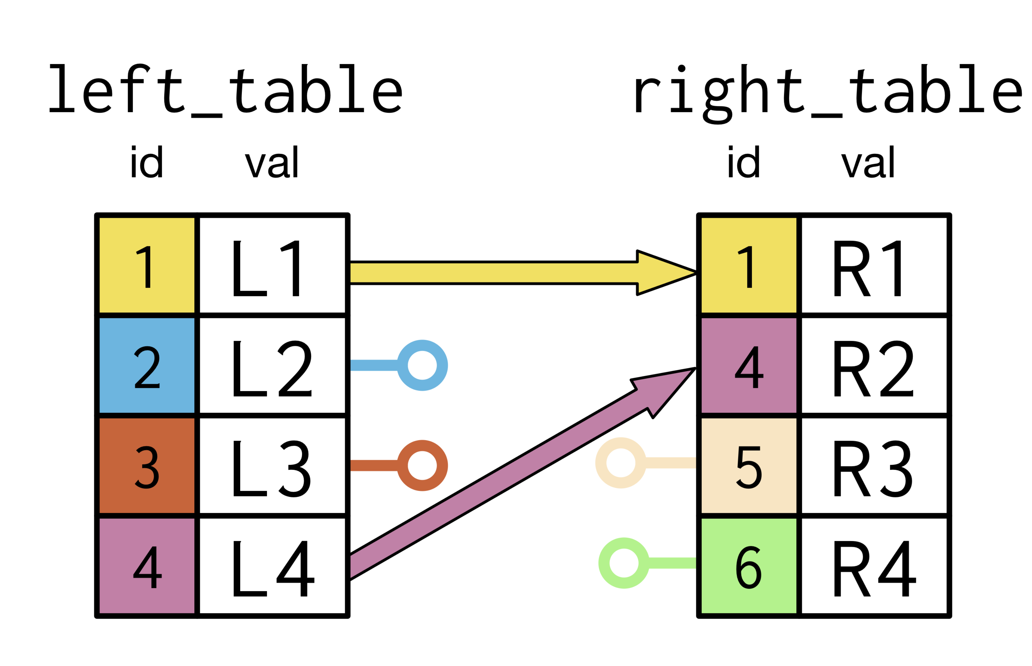
FULL JOIN

Slide 16
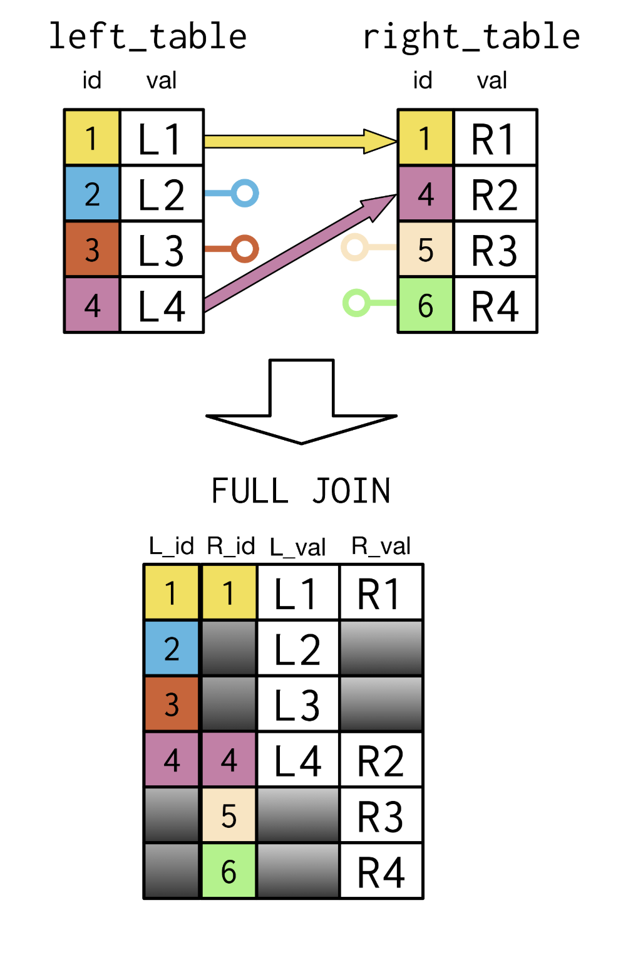
FULL JOIN

Slide 17
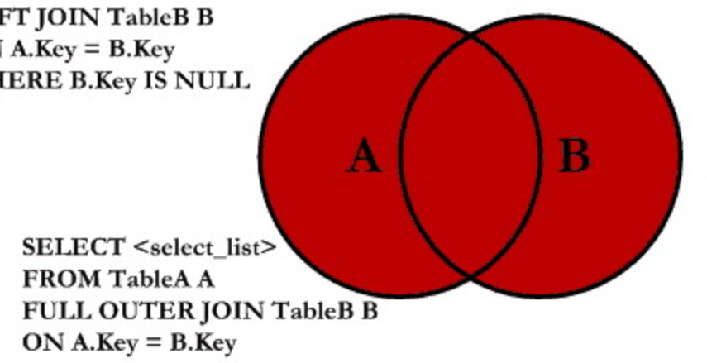
FULL JOIN FORM

